Slide 1
探索
Host Only
網卡名稱為何?
IP為何?
是否能連到外網?
NAT
網卡名稱為何?
IP為何?
是否能連到外網?
Bridge
IP為何?
是否能連到外網?

Slide 2
練習
目前在Host only啟動Vmware workstation player
用ip address命令查看IP(命令小寫)
ping -c 3 8.8.8.8 (查看是否能連到外網)
退出VM workstation player
network Adapter Host only改成NAT
啟動Vmware workstation player
用ip address命令查看IP(命令小寫)
ping -c 3 8.8.8.8 (查看是否能連到外網)
network Adapter NAT改成Bridge
用ip addres命令查看IP(命令小寫)
Ping –c 3 8.8.8.8 (查看是否能連到外網)
Software Updates
Ubuntu desktop setting
補充
按[視窗鍵] 出現 圖示
看設定
網卡連接改選 NAT

Slide 3
目前在Host only啟動Vmware workstation player
Ctrl+G 切到VMare
Ctrl+Alt 切到windows

Slide 4
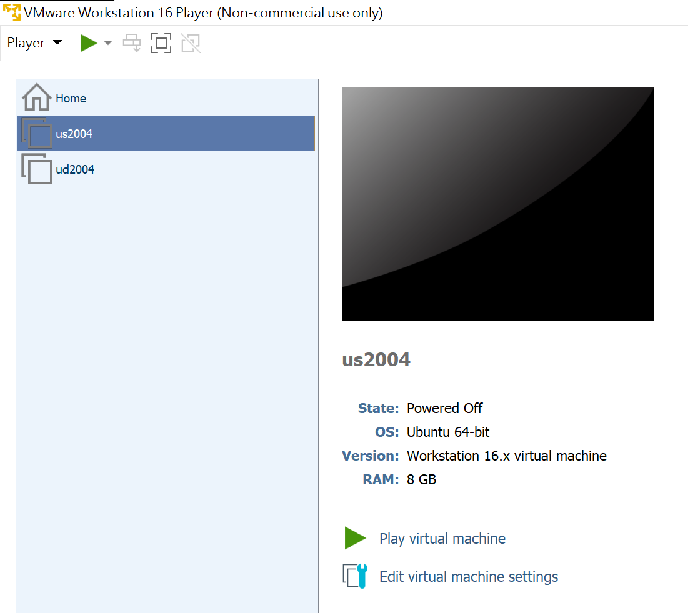
1.選虛擬機[本例us2004]1，選[Play Virtual Machine]2
1
2

Slide 5
Host only
login as: bigred
bigred@192.168.66.129's password:
Welcome to Ubuntu 20.04.1 LTS (GNU/Linux 5.4.0-48-generic x86_64)
* Documentation: https://help.ubuntu.com
* Management: https://landscape.canonical.com
* Support: https://ubuntu.com/advantage
System information as of Sun 11 Oct 2020 01:14:59 PM UTC
System load: 0.07 Processes: 264
Usage of /: 24.2% of 28.91GB Users logged in: 1
Memory usage: 4% IPv4 address for ens33: 192.168.66.129
Swap usage: 0%
54 updates can be installed immediately.
0 of these updates are security updates.
To see these additional updates run: apt list --upgradable
Last login: Sun Oct 11 13:12:52 2020
bigred@us2004:~$

Slide 6
用ip address命令查看IP(命令小寫)
Hosy only 網卡名稱VMnet1

Slide 7
查IP指令ip address
bigred@us2004:~$ ip address
1: lo: <LOOPBACK,UP,LOWER_UP> mtu 65536 qdisc noqueue state UNKNOWN group default qlen 1000
link/loopback 00:00:00:00:00:00 brd 00:00:00:00:00:00
inet 127.0.0.1/8 scope host lo
valid_lft forever preferred_lft forever
inet6 ::1/128 scope host
valid_lft forever preferred_lft forever
2: ens33: <BROADCAST,MULTICAST,UP,LOWER_UP> mtu 1500 qdisc fq_codel state UP group default qlen 1000
link/ether 00:0c:29:c7:81:0d brd ff:ff:ff:ff:ff:ff
inet 192.168.66.129/24 brd 192.168.66.255 scope global dynamic ens33
valid_lft 1240sec preferred_lft 1240sec
inet6 fe80::20c:29ff:fec7:810d/64 scope link
valid_lft forever preferred_lft forever
Notes:
Putty host only可進入

Slide 8
補充
Host only 網卡名稱 VMnet1

Slide 9
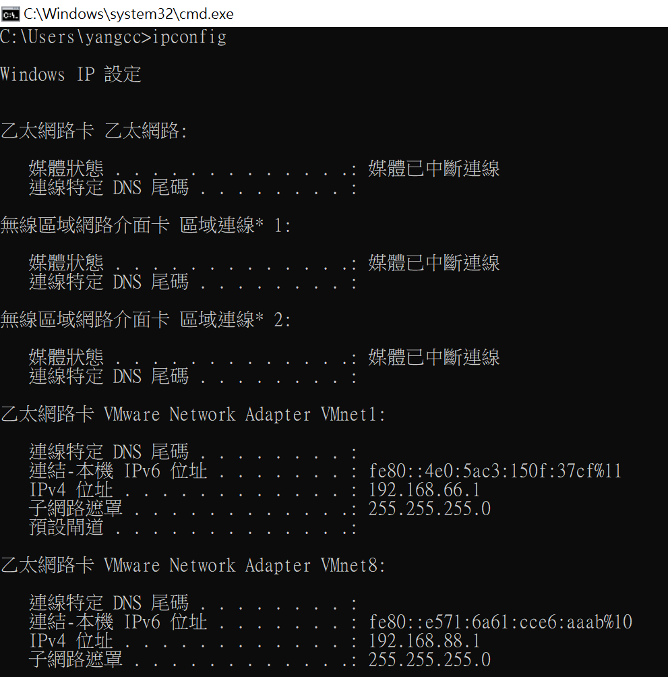
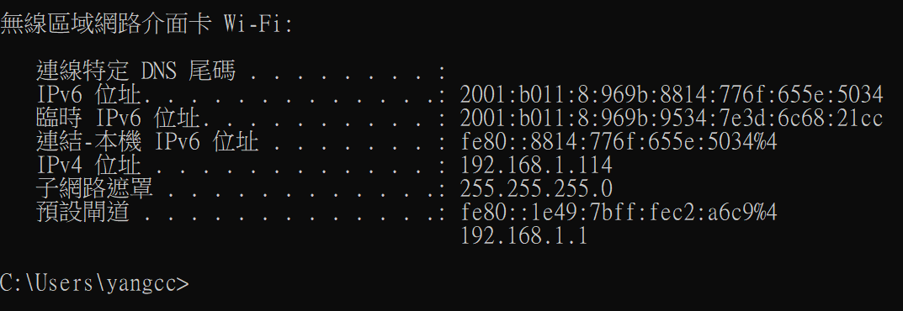
補充: 在DOS視窗輸入ipconfig

Slide 10
ping -c 3 8.8.8.8 (查看是否能連到外網)

Slide 11
ping -c 3 8.8.8.8 (查看是否能上網)
bigred@us2004:~$ ping -c 3 8.8.8.8
ping: connect: Network is unreachable
bigred@us2004:~$

Slide 12
退出VM workstation player

Slide 13
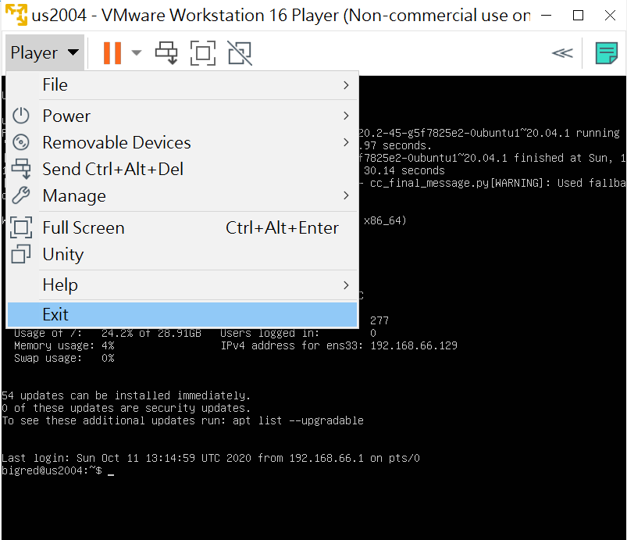
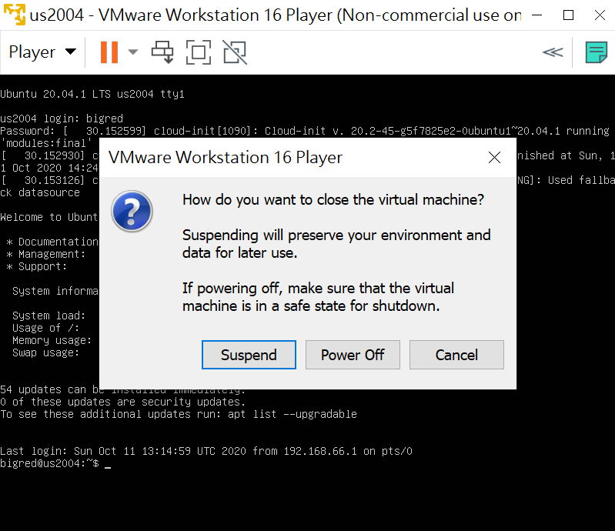
1.選[player]1[Exit]2，選[power off]3
1
2
3

Slide 14
network Adapter Host only改成NAT

Slide 15
1. 1.選虛擬機[本例us2004]1，選[Edit Virtual Machine settings]2
1
2

Slide 16
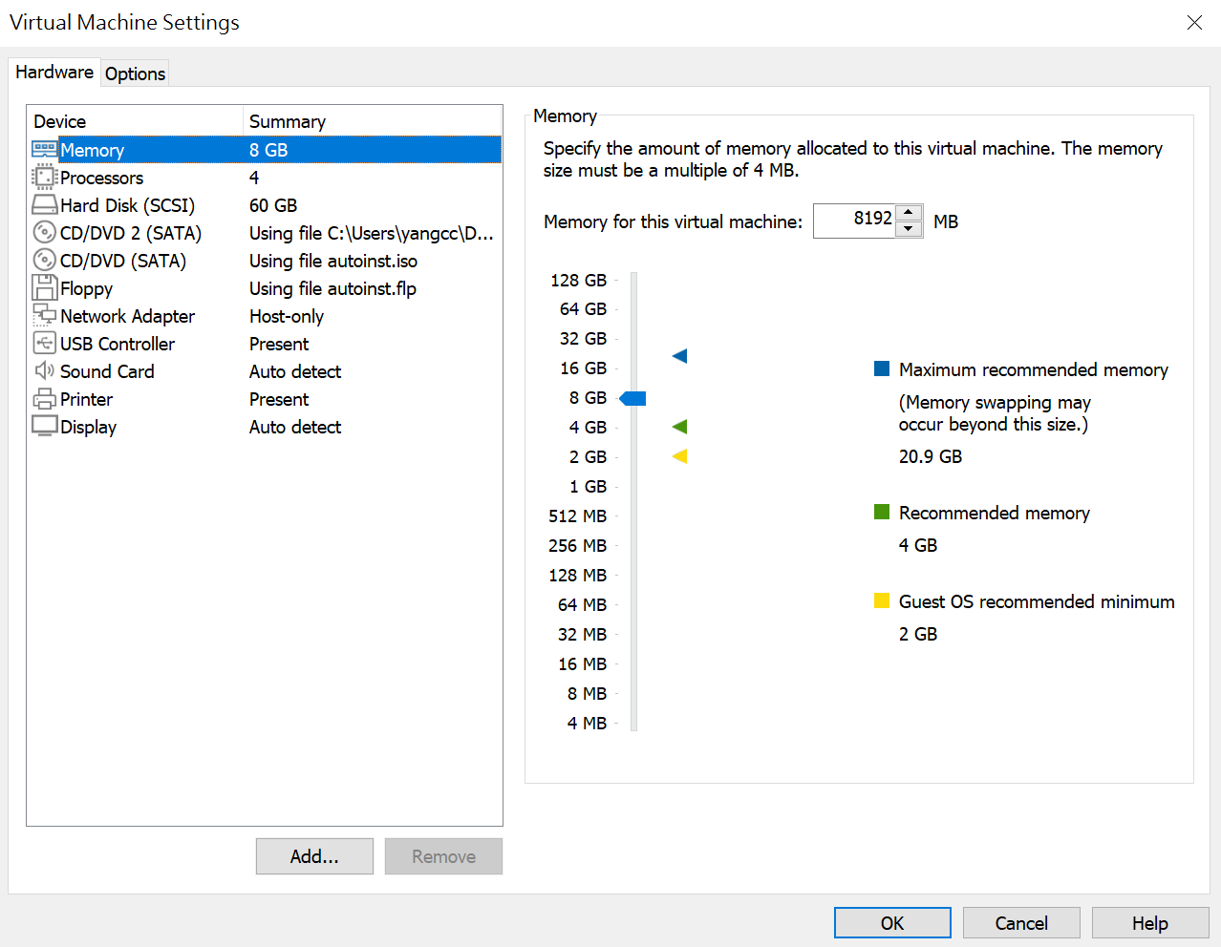
2.選[Network Adapter]3
3

Slide 17
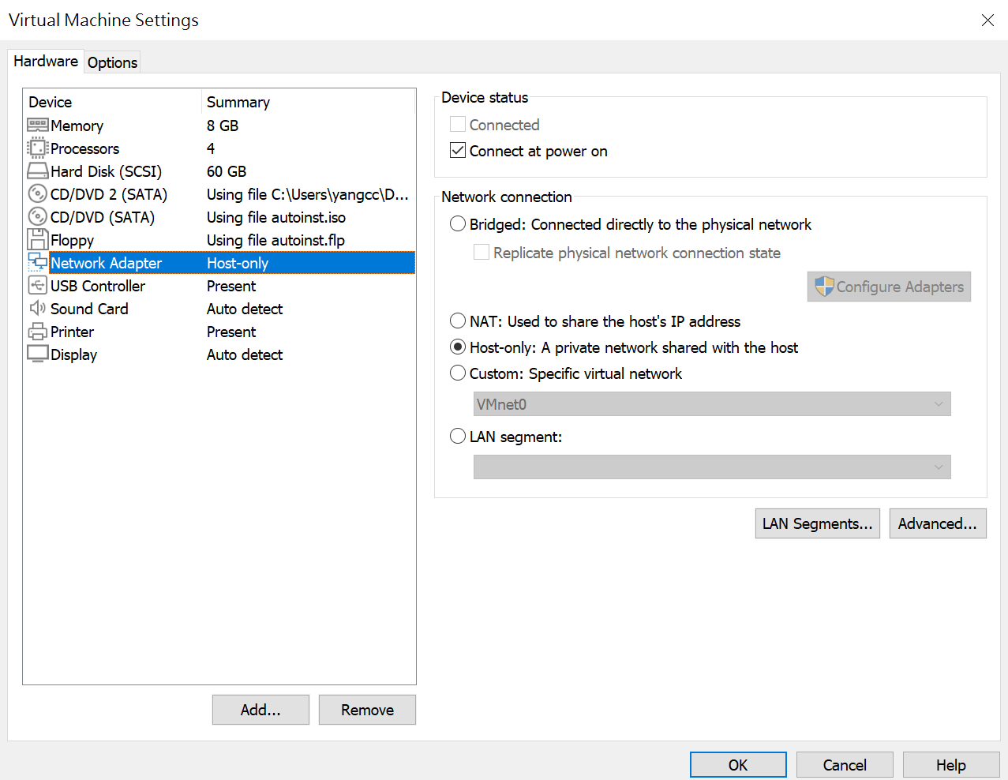
3.選NAT(目前Host only改成NAT)4，選[Ok]5
4
5

Slide 18
4.選虛擬機[本例us2004]5，選[Play Virtual Machine]2
5
6

Slide 19
啟動Vmware workstation player
Ctrl+G 切到VMare
Ctrl+Alt 切到windows
目前 為 NAT
網卡名稱 VMnet8

Slide 20
1.選虛擬機[本例us2004]1，選[Play Virtual Machine]2
1
2

Slide 21
NAT
login as: bigred
bigred@192.168.88.128's password:
Welcome to Ubuntu 20.04.1 LTS (GNU/Linux 5.4.0-48-generic x86_64)
* Documentation: https://help.ubuntu.com
* Management: https://landscape.canonical.com
* Support: https://ubuntu.com/advantage
System information as of Sun 11 Oct 2020 03:04:44 PM UTC
System load: 0.13 Processes: 268
Usage of /: 24.3% of 28.91GB Users logged in: 1
Memory usage: 4% IPv4 address for ens33: 192.168.88.128
Swap usage: 0%
54 updates can be installed immediately.
0 of these updates are security updates.
To see these additional updates run: apt list --upgradable
Last login: Sun Oct 11 15:02:41 2020

Slide 22
用ip address命令查看IP(命令小寫)
目前 為 NAT

Slide 23
ip address
NAT
bigred@us2004:~$ ip address
1: lo: <LOOPBACK,UP,LOWER_UP> mtu 65536 qdisc noqueue state UNKNOWN group default qlen 1000
link/loopback 00:00:00:00:00:00 brd 00:00:00:00:00:00
inet 127.0.0.1/8 scope host lo
valid_lft forever preferred_lft forever
inet6 ::1/128 scope host
valid_lft forever preferred_lft forever
2: ens33: <BROADCAST,MULTICAST,UP,LOWER_UP> mtu 1500 qdisc fq_codel state UP group default qlen 1000
link/ether 00:0c:29:c7:81:0d brd ff:ff:ff:ff:ff:ff
inet 192.168.88.128/24 brd 192.168.88.255 scope global dynamic ens33
valid_lft 1450sec preferred_lft 1450sec
inet6 fe80::20c:29ff:fec7:810d/64 scope link
valid_lft forever preferred_lft forever
bigred@us2004:~$

Slide 24
補充
NET 網卡名稱 VMnet8

Slide 25
補充: 在DOS視窗輸入ipconfig

Slide 26
ping -c 3 8.8.8.8 (查看是否能連到外網)
NAT 能連到外網

Slide 27
ping –c 3 8.8.8.8
bigred@us2004:~$ ping -c 3 8.8.8.8
PING 8.8.8.8 (8.8.8.8) 56(84) bytes of data.
64 bytes from 8.8.8.8: icmp_seq=1 ttl=128 time=8.26 ms
64 bytes from 8.8.8.8: icmp_seq=2 ttl=128 time=7.84 ms
64 bytes from 8.8.8.8: icmp_seq=3 ttl=128 time=8.68 ms
--- 8.8.8.8 ping statistics ---
3 packets transmitted, 3 received, 0% packet loss, time 2004ms
rtt min/avg/max/mdev = 7.839/8.262/8.684/0.344 ms
bigred@us2004:~$

Slide 28
network Adapter NAT改成Bridge
VMware不用 [Exit]與[power off]
直接
選[player][Removable Devices][Network Adapter][Settings...]去設定

Slide 29
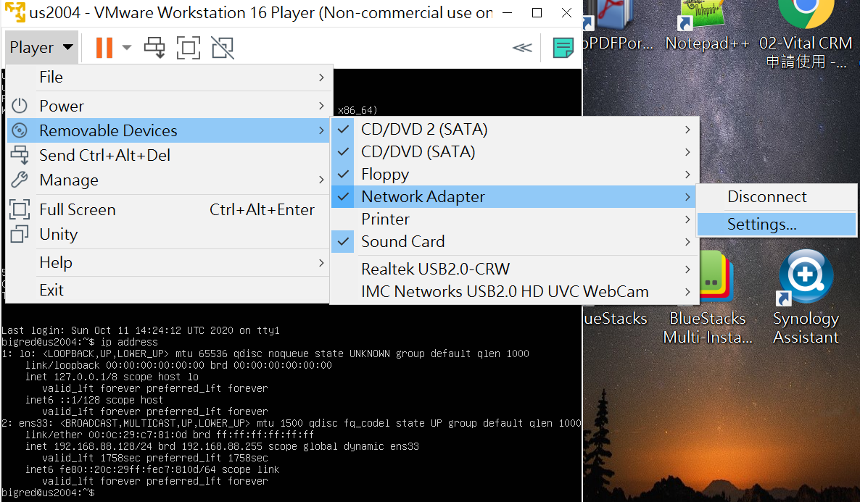
1.選[player]1[Removable Devices]2[Network Adapter]3[Settings...]4
1
2
3
4

Slide 30
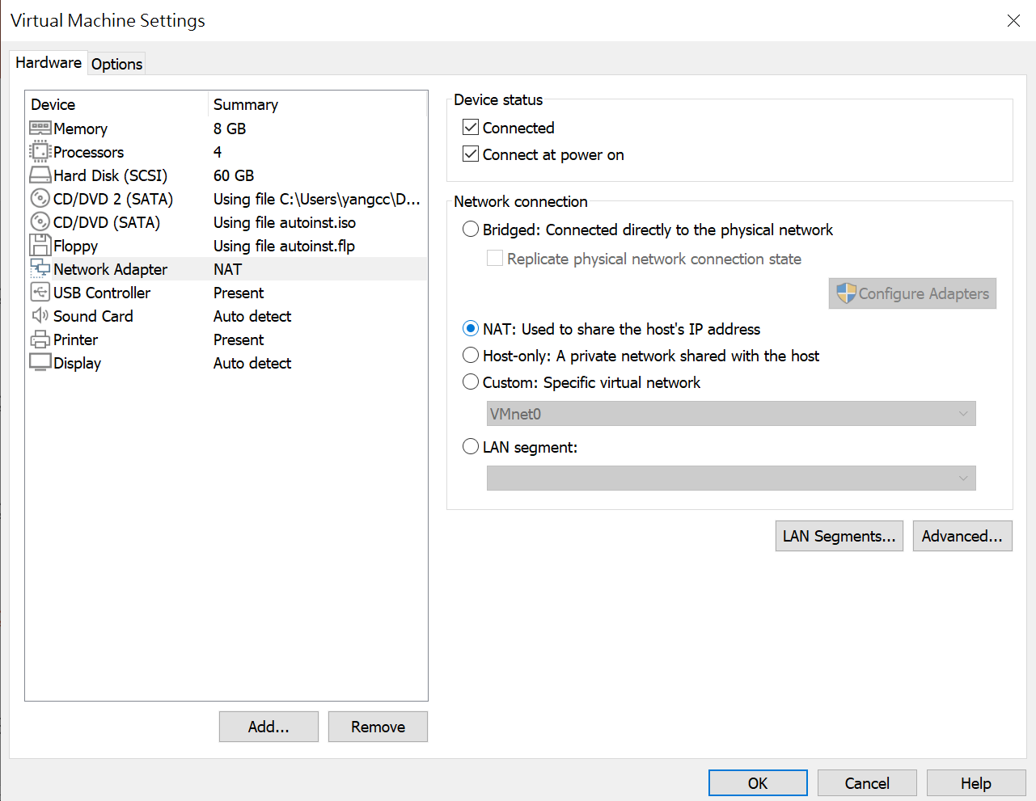
2.選[Bridge :Connected directly to the physical network]5
5

Slide 31
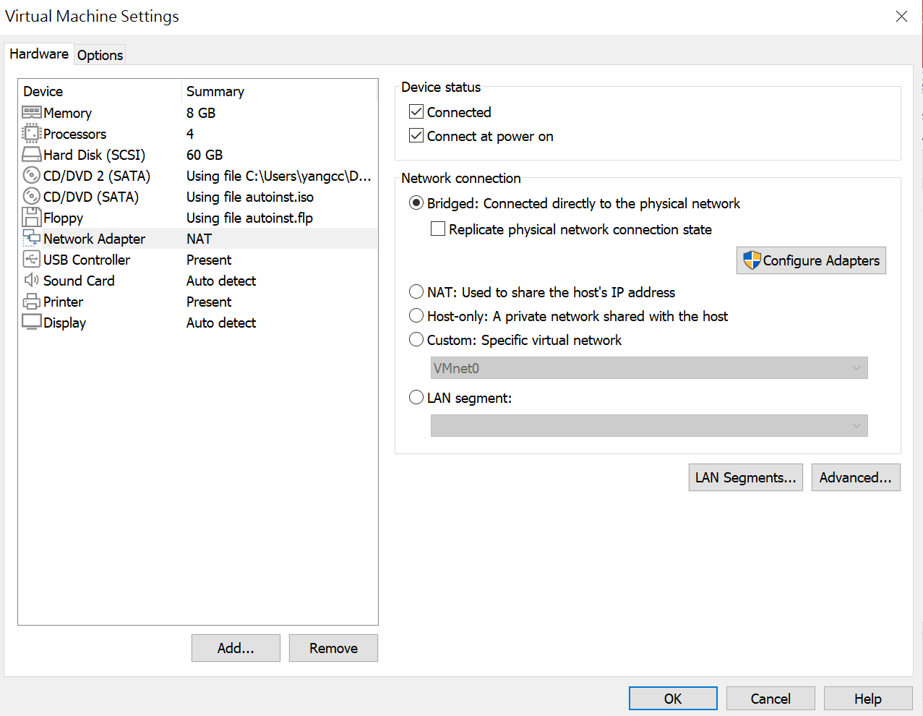
3.選[ok]6
6

Slide 32
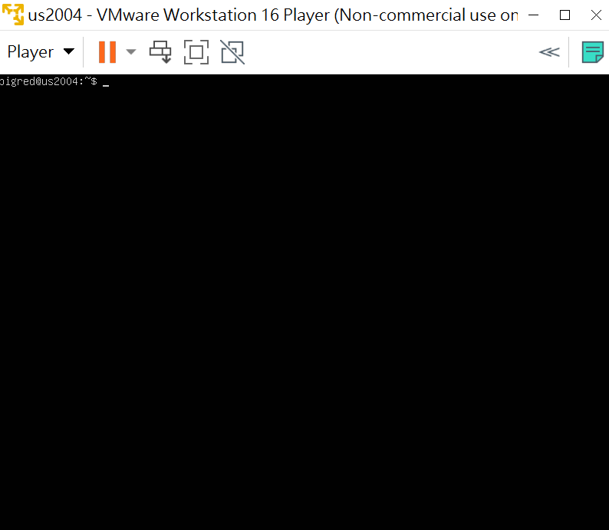
7.返回Vmware(未關機直接切過來)

Slide 33
用ip addres命令查看IP(命令小寫)
bridge

Slide 34
bigred@us2004:~$ ip address
1: lo: <LOOPBACK,UP,LOWER_UP> mtu 65536 qdisc noqueue state UNKNOWN group default qlen 1000
link/loopback 00:00:00:00:00:00 brd 00:00:00:00:00:00
inet 127.0.0.1/8 scope host lo
valid_lft forever preferred_lft forever
inet6 ::1/128 scope host
valid_lft forever preferred_lft forever
2: ens33: <BROADCAST,MULTICAST,UP,LOWER_UP> mtu 1500 qdisc fq_codel state UP group default qlen 1000
link/ether 00:0c:29:c7:81:0d brd ff:ff:ff:ff:ff:ff
inet 192.168.1.123/24 brd 192.168.1.255 scope global dynamic ens33
valid_lft 604688sec preferred_lft 604688sec
inet6 2001:b011:8:969b:20c:29ff:fec7:810d/64 scope global dynamic mngtmpaddr noprefixroute
valid_lft 61453sec preferred_lft 61453sec
inet6 fe80::20c:29ff:fec7:810d/64 scope link
valid_lft forever preferred_lft forever
bigred@us2004:~$

Slide 35
補充
bridge 與 電腦 上網的WIFI 同網段

Slide 36
補充: 在DOS視窗輸入ipconfig

Slide 37
Ping –c 3 8.8.8.8 (查看是否能連到外網)

Slide 38
bigred@us2004:~$ ping -c 3 8.8.8.8
PING 8.8.8.8 (8.8.8.8) 56(84) bytes of data.
64 bytes from 8.8.8.8: icmp_seq=1 ttl=116 time=6.52 ms
64 bytes from 8.8.8.8: icmp_seq=2 ttl=116 time=5.49 ms
64 bytes from 8.8.8.8: icmp_seq=3 ttl=116 time=5.81 ms
--- 8.8.8.8 ping statistics ---
3 packets transmitted, 3 received, 0% packet loss, time 2005ms
rtt min/avg/max/mdev = 5.492/5.938/6.517/0.428 ms
Notes:
Google原本就已經在其Google Chrome瀏覽器內建了
「DNS預先擷取」功能來加快瀏覽器開啟網頁的反應速度，
現在又更進一步提供了公用的DNS伺服器
主DNS伺服器IP(ipv4)： 8.8.8.8
次DNS伺服器IP(ipv4)： 8.8.4.4
主DNS伺服器IP(ipv6)： 2001:4860:4860::8888
次DNS伺服器IP(ipv6)： 2001:4860:4860::8844
所謂的DNS服務就是當我們在網址列輸入「http://www.google.com」網址
（一個較好記的名稱）的時候，
電腦會透過DNS伺服器的解析服務，
得知該網址所要前往的IP位址（一串較難記憶的數字）
而找到網站伺服器、取得並顯示網頁資料。

Slide 39
DNS伺服器(Domain name server)
Google原本就已經在其Google Chrome瀏覽器內建了
「DNS預先擷取」功能來加快瀏覽器開啟網頁的反應速度，
現在又更進一步提供了公用的DNS伺服器
主DNS伺服器IP(ipv4)： 8.8.8.8
次DNS伺服器IP(ipv4)： 8.8.4.4
主DNS伺服器IP(ipv6)： 2001:4860:4860::8888
次DNS伺服器IP(ipv6)： 2001:4860:4860::8844
所謂的DNS服務就是當我們在網址列輸入「http://www.google.com」網址
（一個較好記的名稱）的時候，
電腦會透過DNS伺服器的解析服務，
得知該網址所要前往的IP位址（一串較難記憶的數字）
而找到網站伺服器、取得並顯示網頁資料。

Slide 40
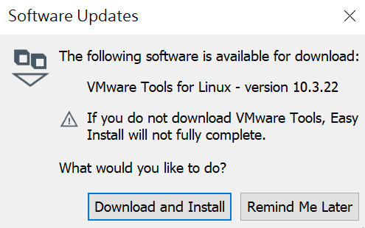
補充:Software Updates

Slide 41
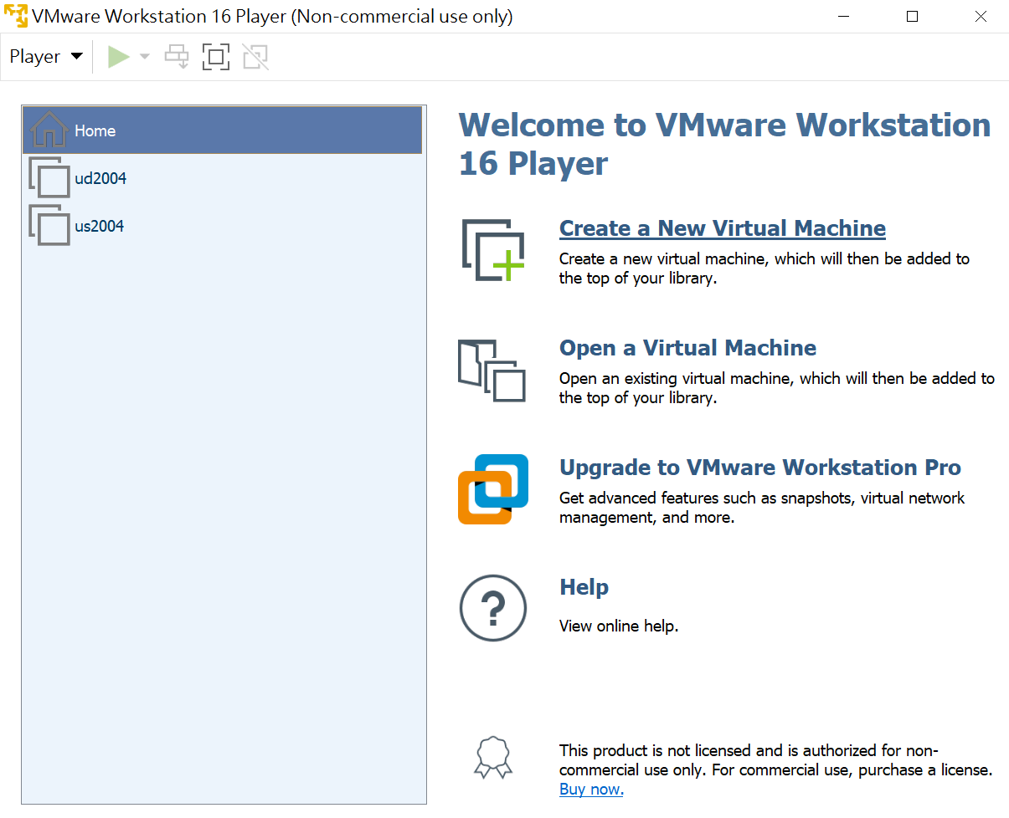
Ubuntu desktop setting
Notes:
USB 4GB+
dual core 2GHz CPU &2GB RAM
Ubuntu 20.04 LTS (Focal Fossa)
support until April 2025
https://www.youtube.com/watch?v=UBCE-ZH_xLA

Slide 42
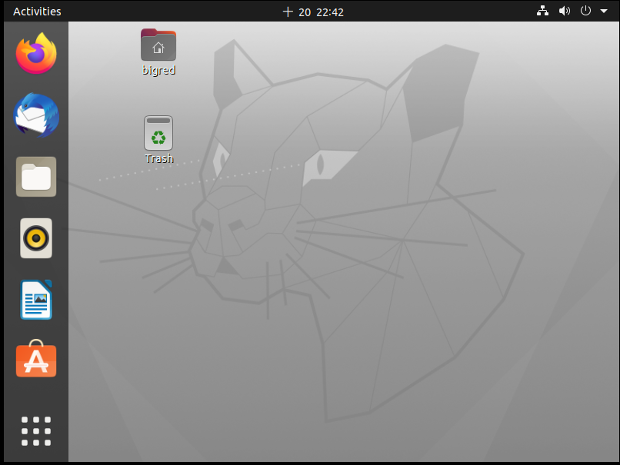

Slide 43
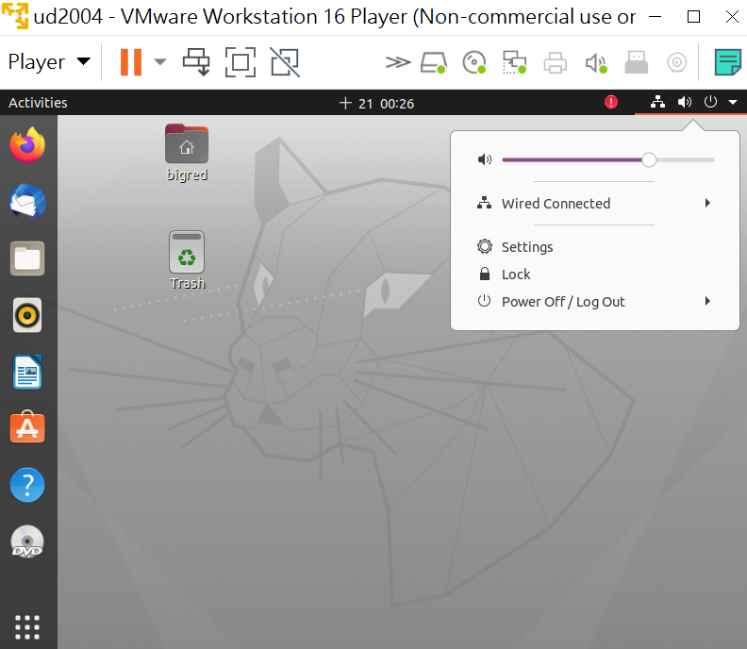
[Setting]

Slide 44
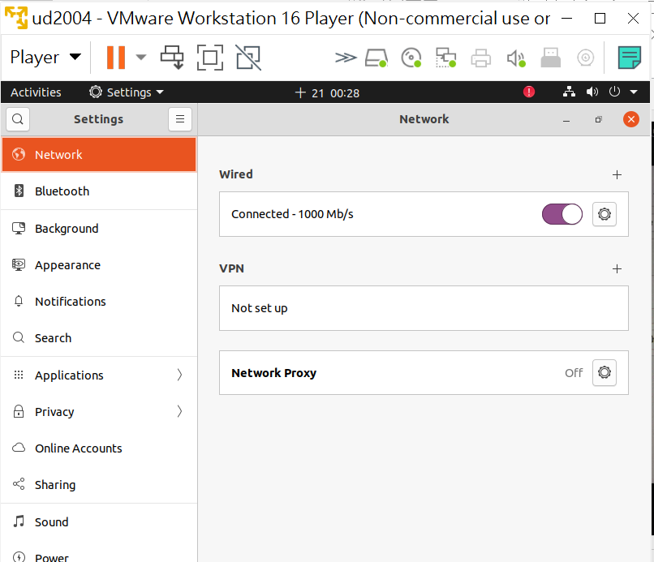
往下移

Slide 45
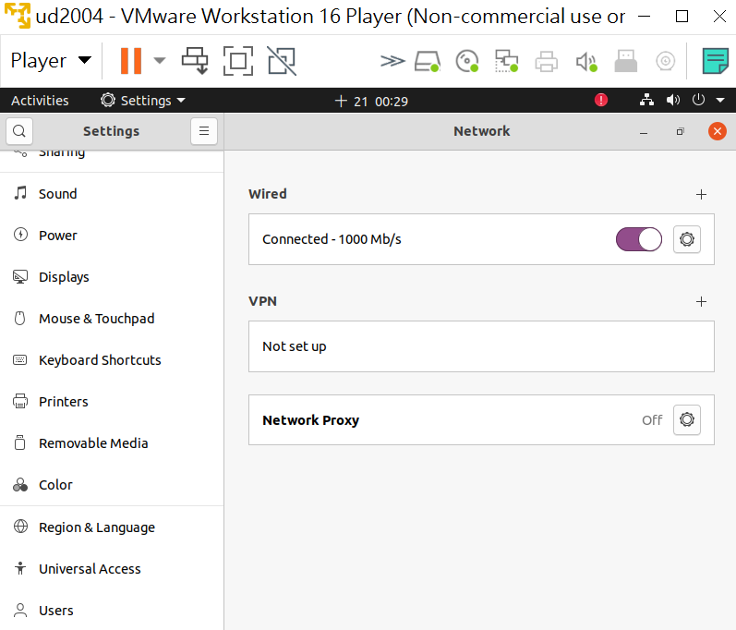
[Displays]

Slide 46
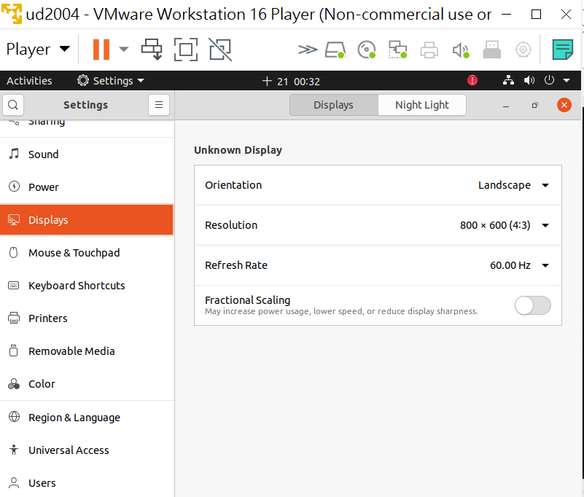
fraction scales分數尺度

Slide 47
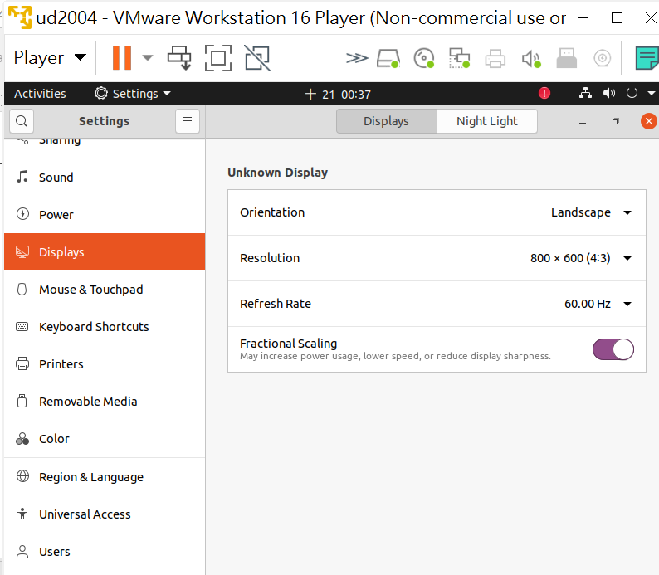
[Resolution]

Slide 48
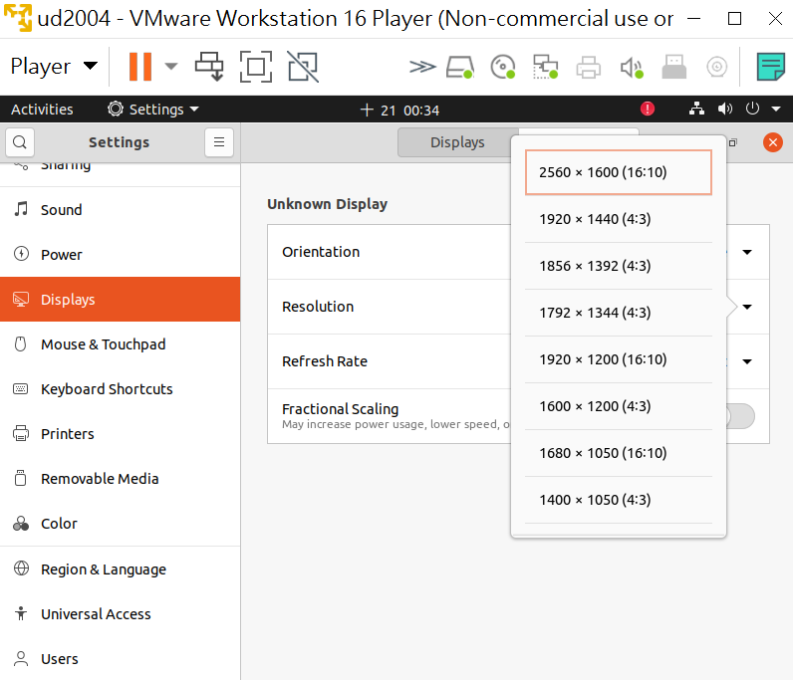
[1920*1200]

Slide 49
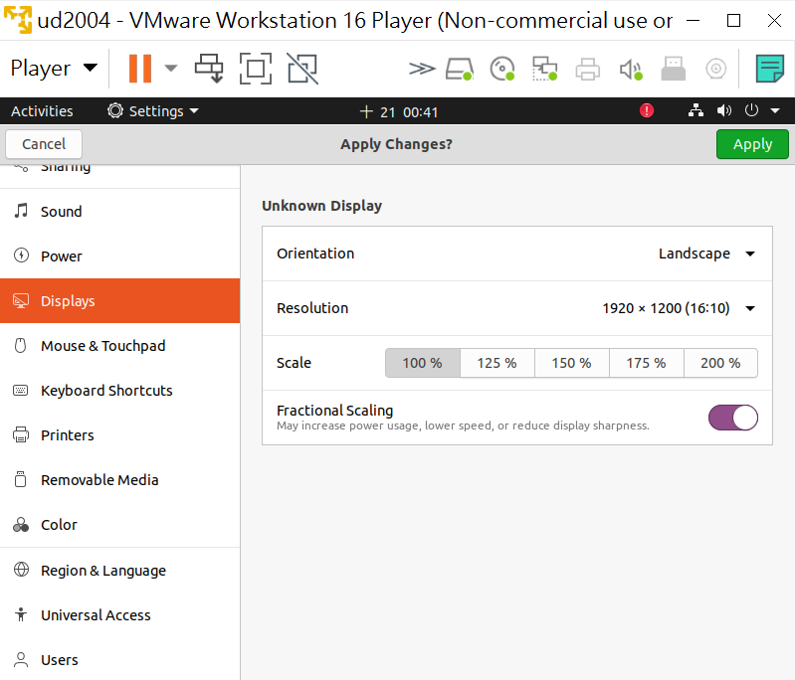
[Apply]

Slide 50
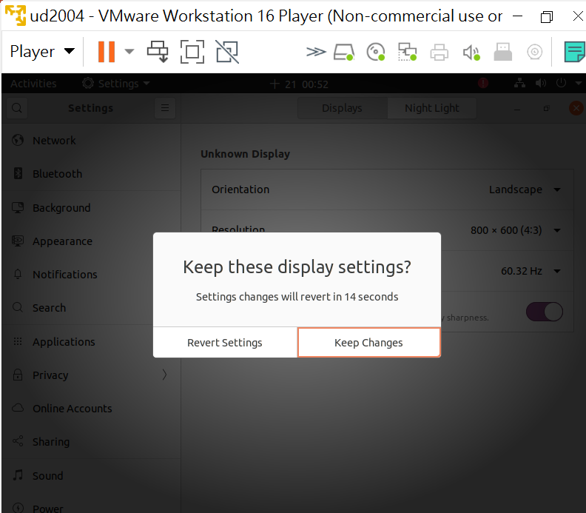
Keep Changes

Slide 51
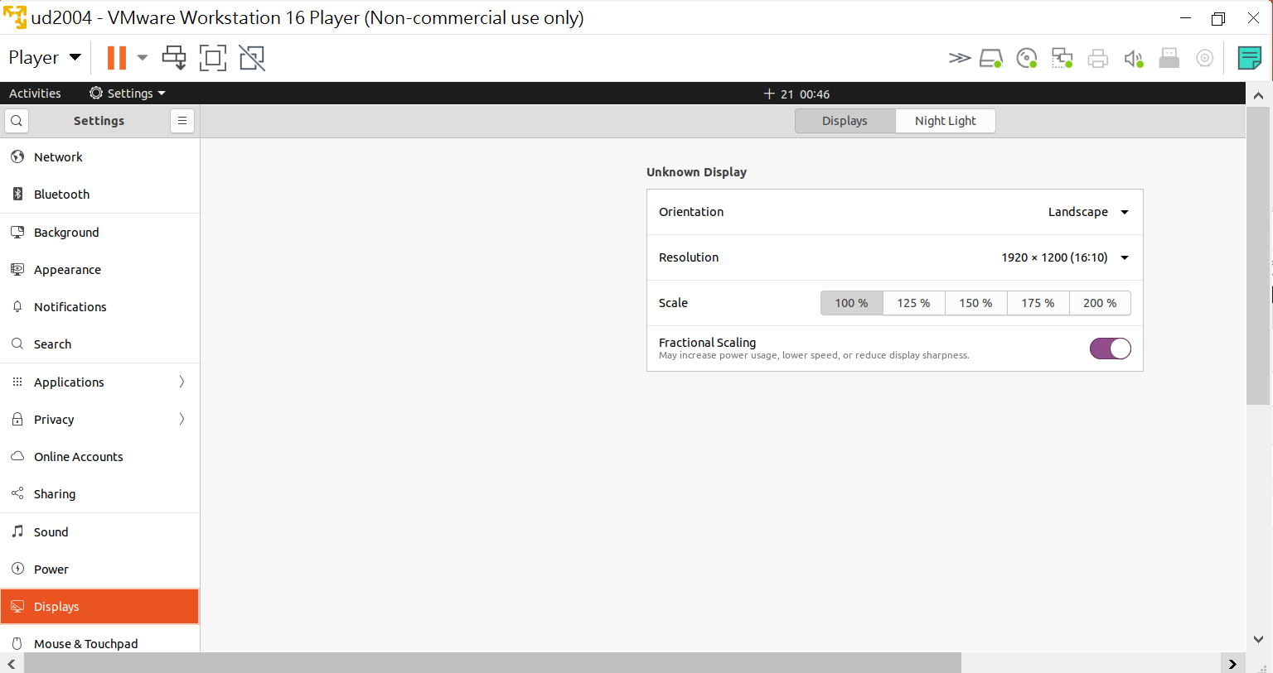
套用結果

Slide 52
補充

Slide 53
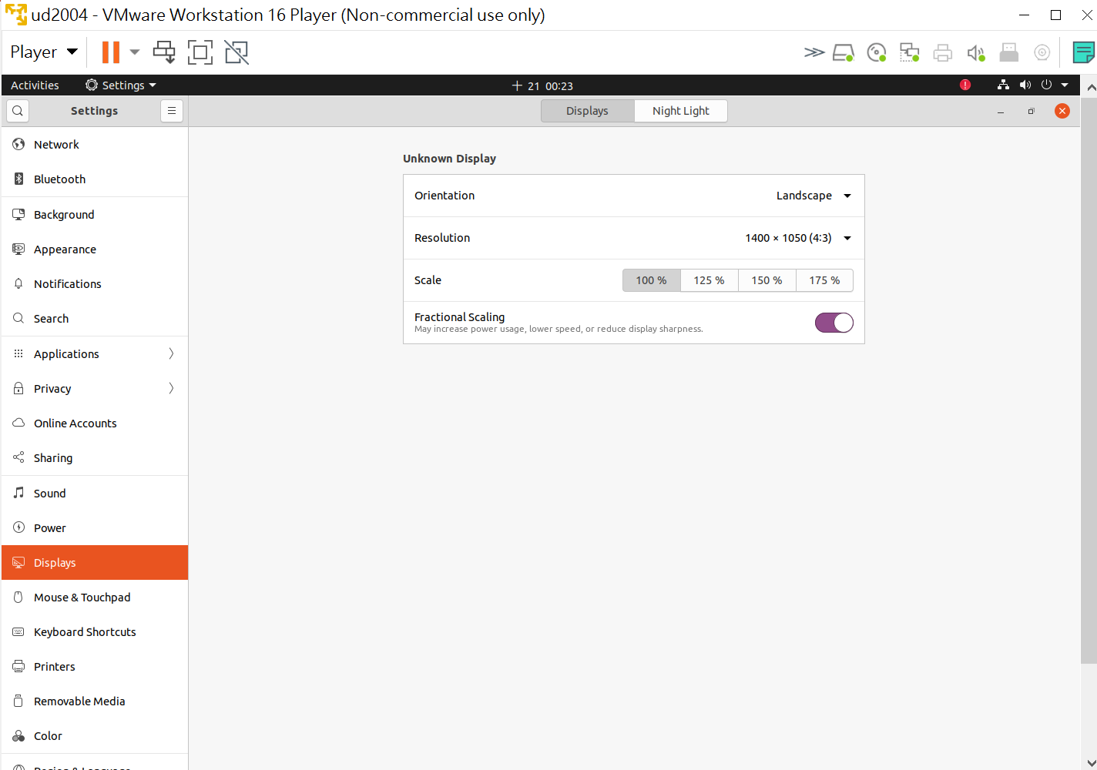
1400*1050 套用結果

Slide 54
按[視窗鍵] 出現 圖示

Slide 55
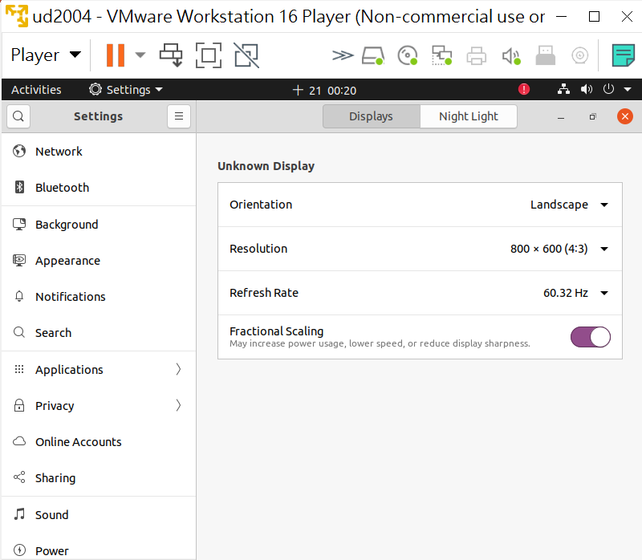
按[視窗鍵]

Slide 56
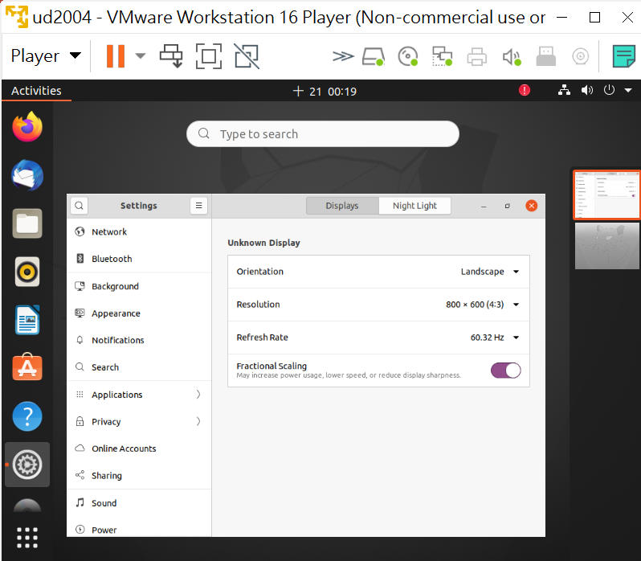

Slide 57
上不了網

Slide 58
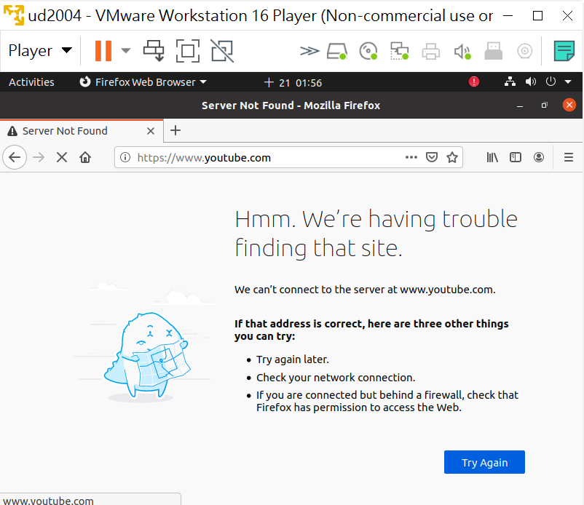

Slide 59
看設定

Slide 60
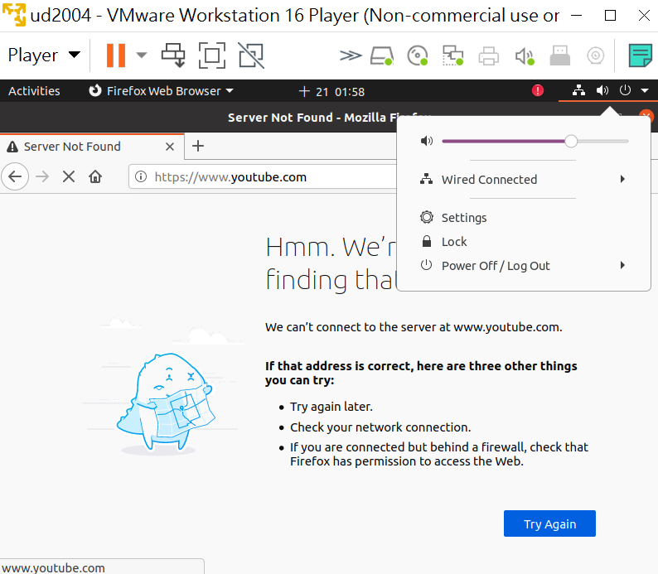
˙

Slide 61
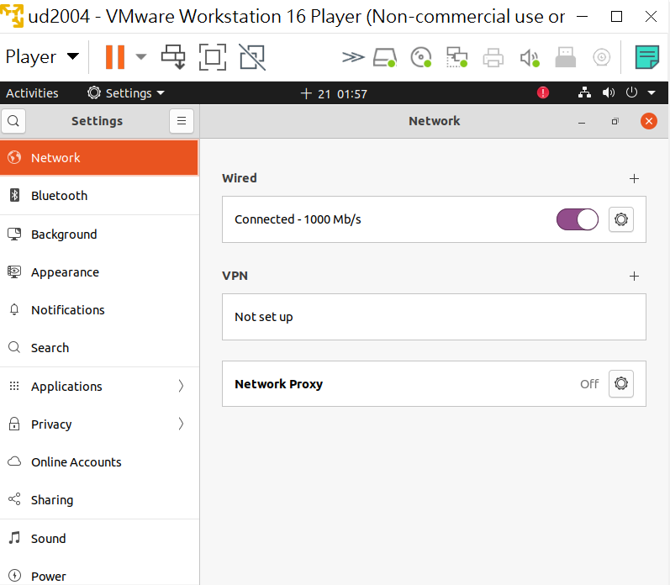
1

Slide 62
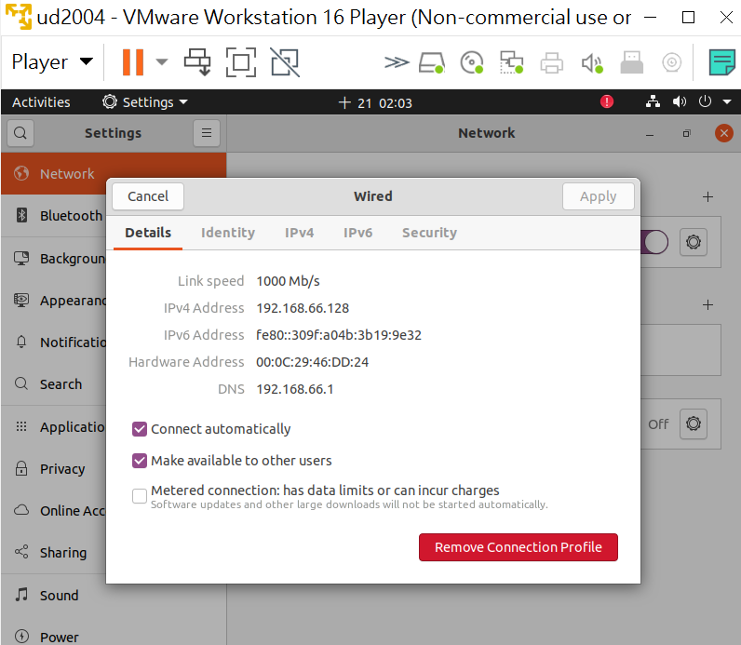
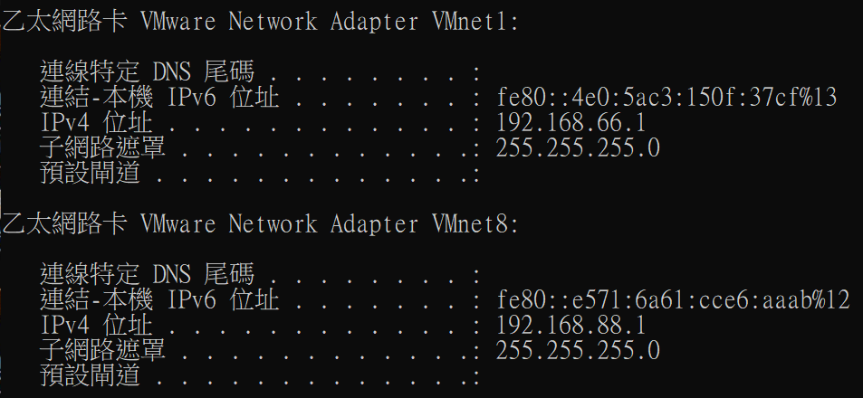
看完選[X]
HOST Only

Slide 63
網卡連接改選 NAT
[Player][Removable Devices][Network Adapter][Setting]

Slide 64
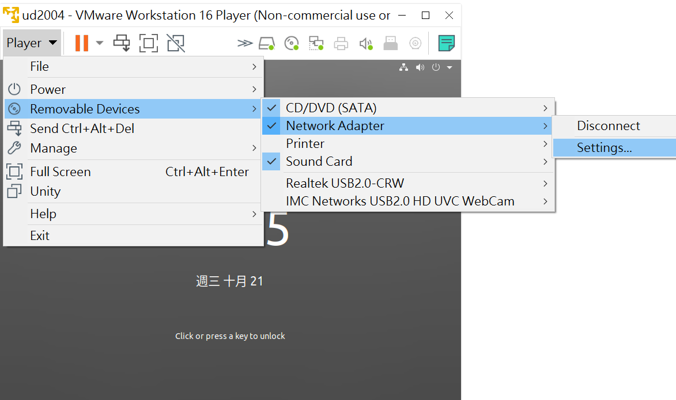
[Player][Removable Devices][Network Adapter][Setting]

Slide 65
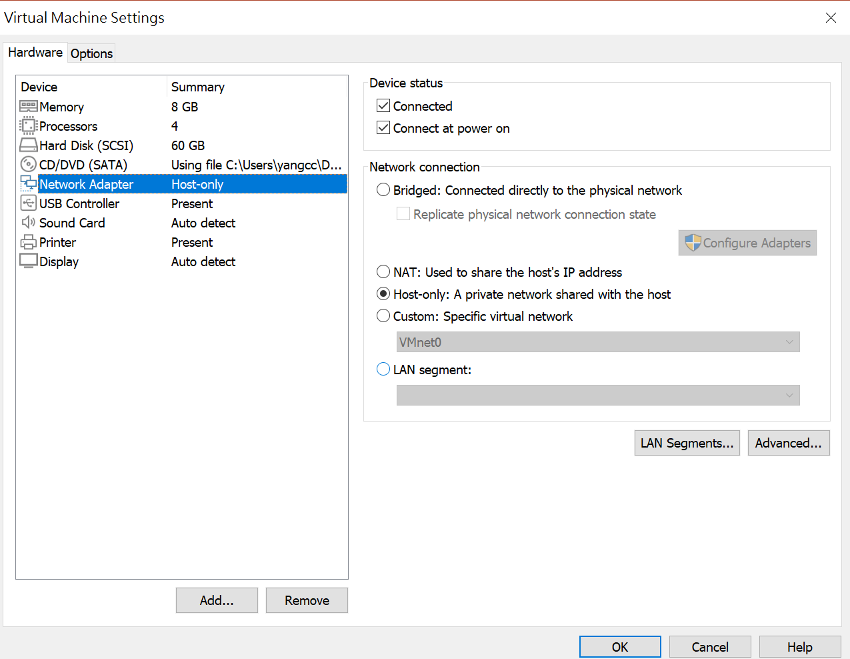
選[NAT]

Slide 66
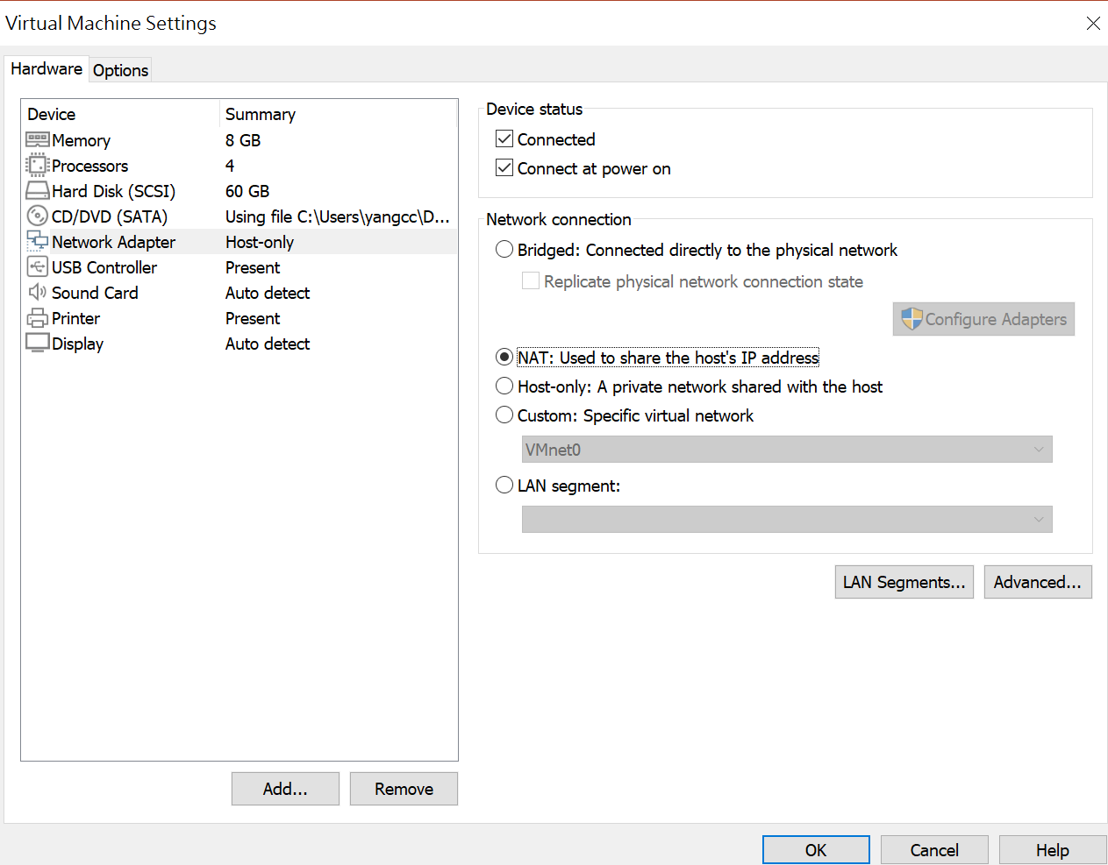
選[OK]

Slide 67
